Slide 1


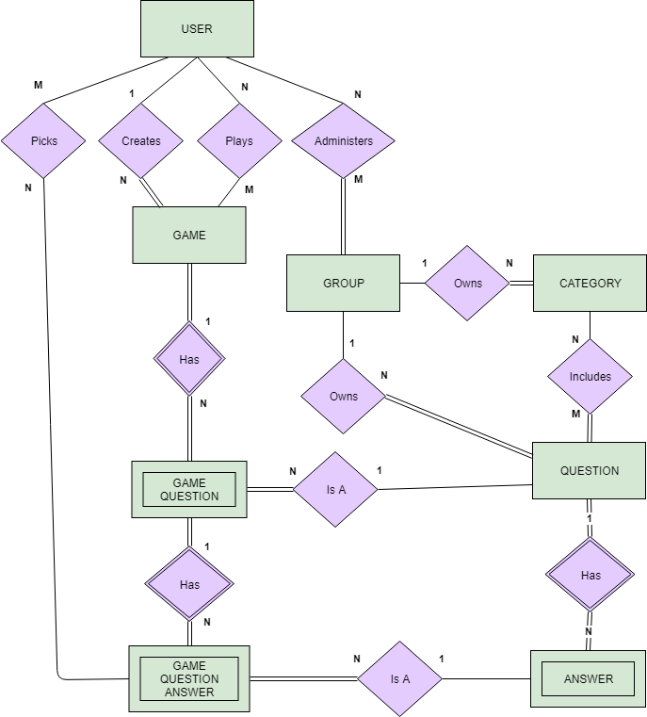
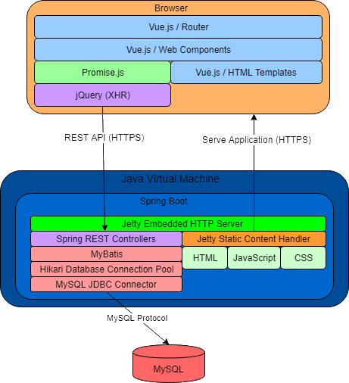


Team Rocket
Bryan Castillo
Trece Wicklander-Bryant
Fatih Ridha
Fahad Alshehri
Rocket Trivia
Motivation
Need for a universal system to create trivia content, play games with others, and view statistics
Current trivia apps allow you to challenge friends to trivia games, but not create content
Play our game!
Scan this QR code or go to
https://www.uwbrockettrivia.net
Methodology
Identified use cases and created Entity Relationship Diagram (ERD; shown left)
Created Relational Model Schema (RMS) in preparation for database creation
Setup database instance on AWS and created initial schema through MySQL
Developed simple web interface in Vue.js to query from database and generate test data
Generated more test data using Python scripts to pull from other sources
Entity Relationship Diagram (ERD)
Rocket Trivia
Rocket Trivia is a database application for creating and running competitive trivia games.
Create trivia categories and questions
Join or host trivia games with other players
View trivia game statistics
Architecture

